Slide 1



Devanshu Mahapatra(20104036)
Athul Nair(20104048)
Subhashish Mahapatra(20104049)
Project Guide
Ms. Roshna Sangle

Slide 2
Contents
Introduction
Objectives
Scope
Literature Survey
Proposed System
Project Outcomes
Block Diagram
Use Case/DFD
Technology Stack
Suggestions in Review-1
Result and Discussion
Conclusion and Future Scope
References

Slide 3
1. Introduction
SocioReact is a web based Application, which is mainly developed in ReactJs (Framework of JS).
Our website allows people to create, share or exchange information, pictures and videos in an user friendly manner.
The main objective of this project is to establish a network among the people residing in all over the world. All the information can be easily accessed and shared among the people in a secure manner.
This service helps to make your social life and that of your friends, more active and stimulating.
SocioReact can help you maintain both existing relationships and establish new one’s by reaching out to people you have never met before.

Slide 4
2. Objectives
To have a search functionality through which people can easily search the entire network.
To Send, Accept and Reject Friend Request between users.
To display a public profile having social, professional and personal information.
To ensure ease of editing profile 24/7.
To ensure chat functionality with sending/receiving of messages. [Future Objective]
To ensure easy way of posting and sharing of Images, Text or any other media on network.

Slide 5
3. Scope
To deploy adaptable real-life applicable model.
To ensure easy way of posting and sharing of Images, Text or any other media on network.
To help people find similar interests.
For future scope, we will be adding:
Chat Functionality
Improved User Interface
Real time implementation.
Further API Integration

Slide 6
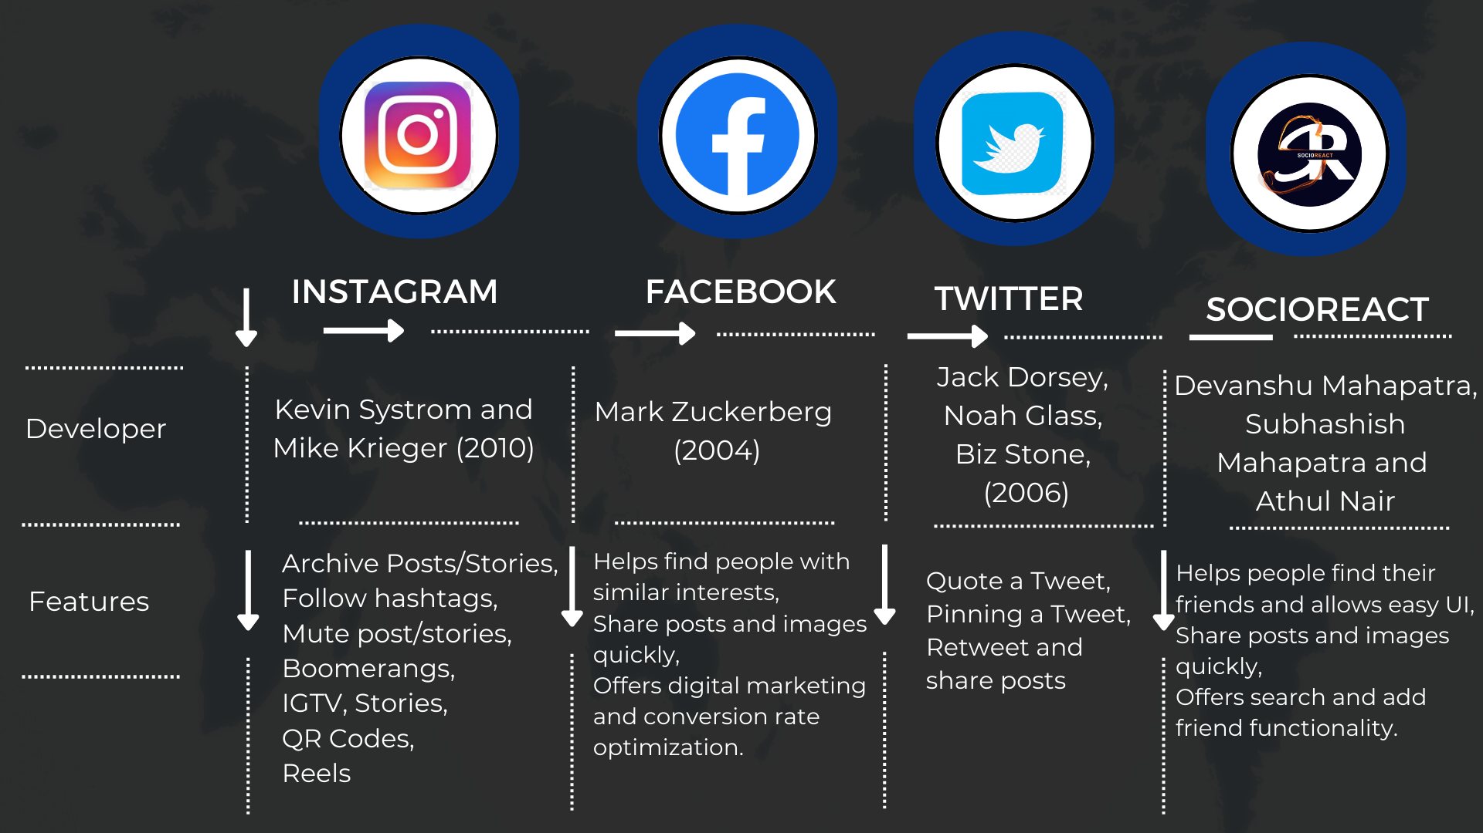
4.1 Literature Survey

Slide 7
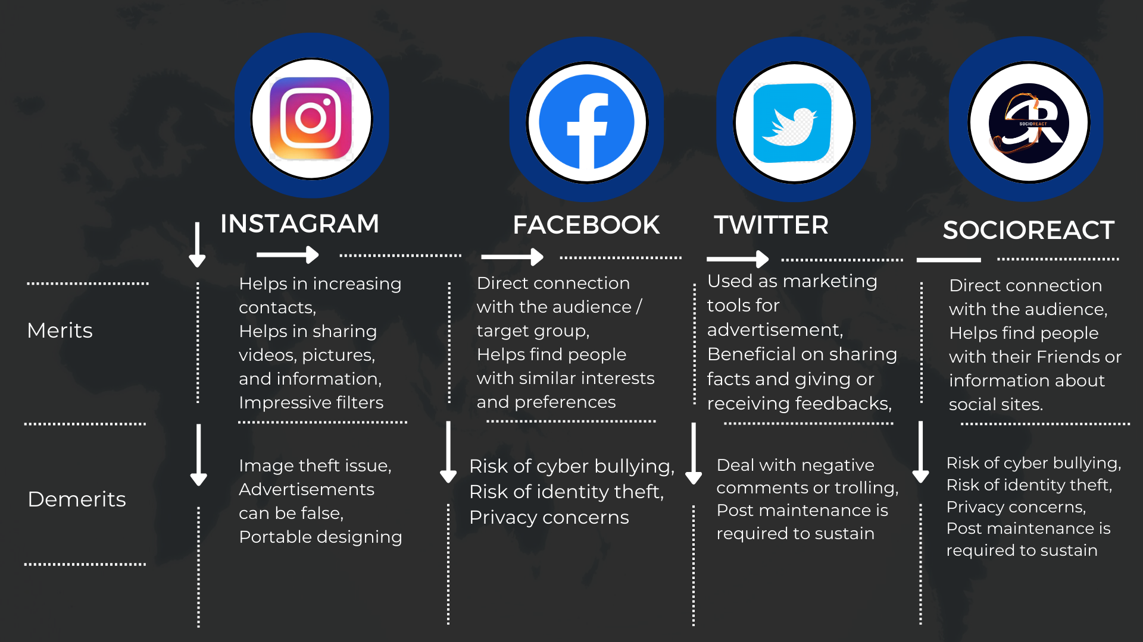
4.2 Literature Survey

Slide 8
5. Proposed System
Provides Searching Facilities Based on various factors such as Users, Posts, Shares, etc.
Authentication Facility such as Google mail facility.
Authorised Users can login, access and edit their profile.
Users can like, comment, share the required posts.
User can Add, Follow or Remove Friends.
Provides Chat Facilities. [Future Implementation]
Provides a daily News update section to keep users informed regarding general news. [Future Implementation]
Live Video Chat Functionality. [Future Implementation]

Slide 9
6. Outcome of Project
User Can login, If in case they Forget their password they can reset their credential through forgot password option.
User can search anyone’s profile and follow/send them a friend request.
Users can chat with other people in real time privately or publicly.

Slide 10
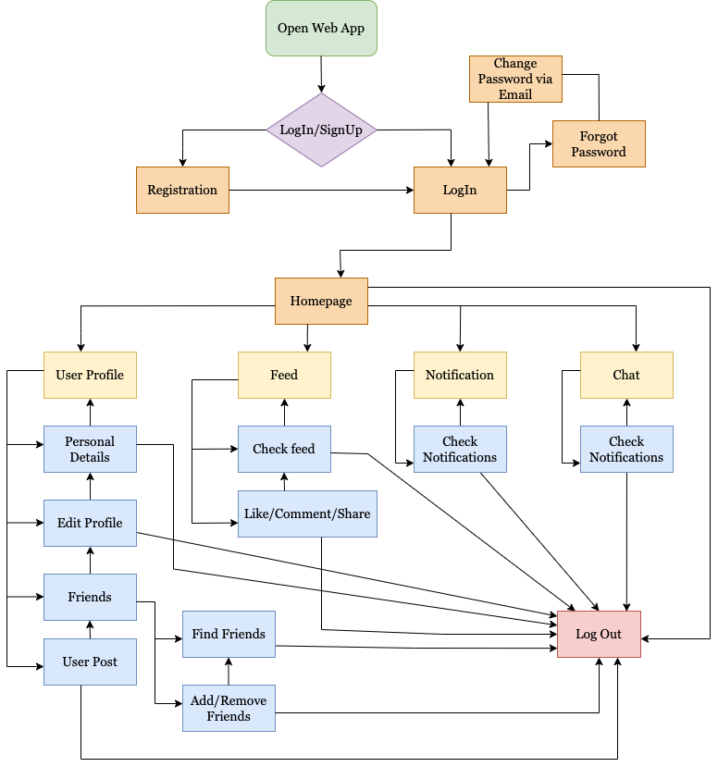
7. Block Diagram ( System Flow)

Slide 11
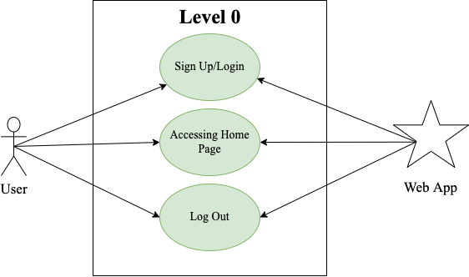
8.1 Use Case

Slide 12
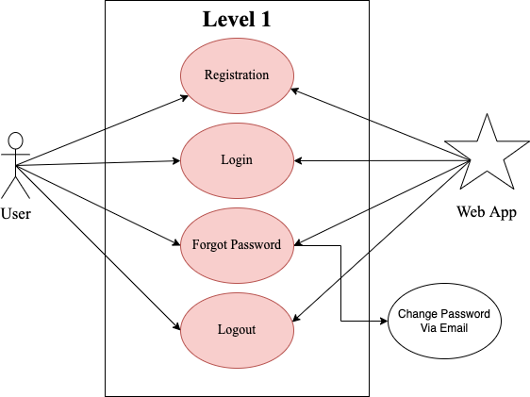
8.2 Use Case

Slide 13
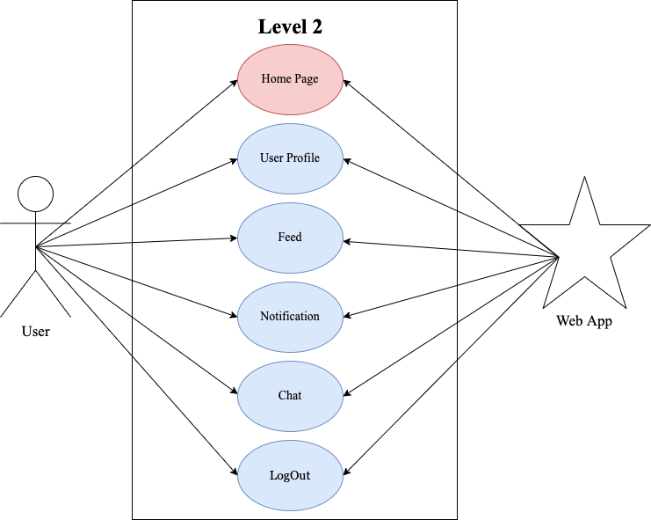
8.3 Use Case

Slide 14
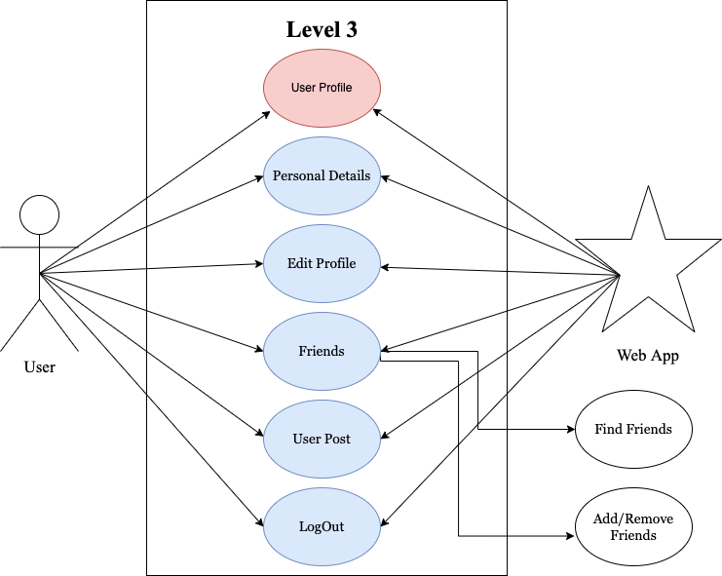
8.4 Use Case

Slide 15
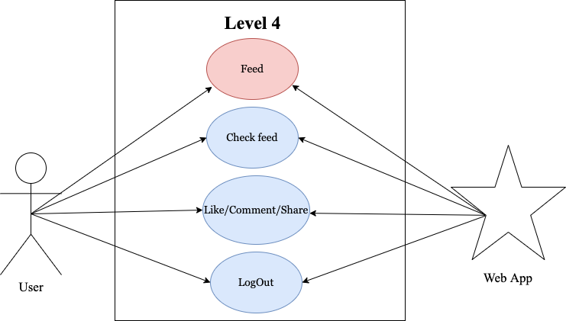
8.5 Use Case

Slide 16
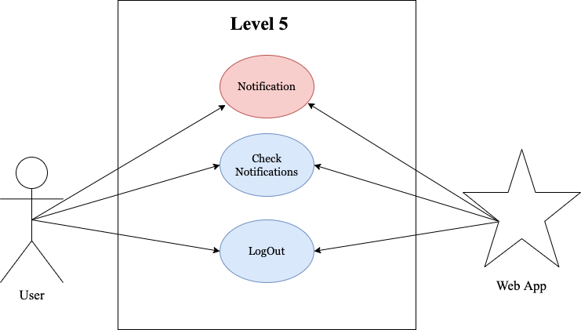
8.6 Use Case

Slide 17

8.7 Use Case

Slide 18
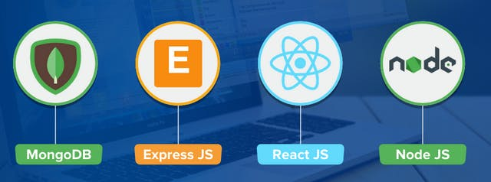


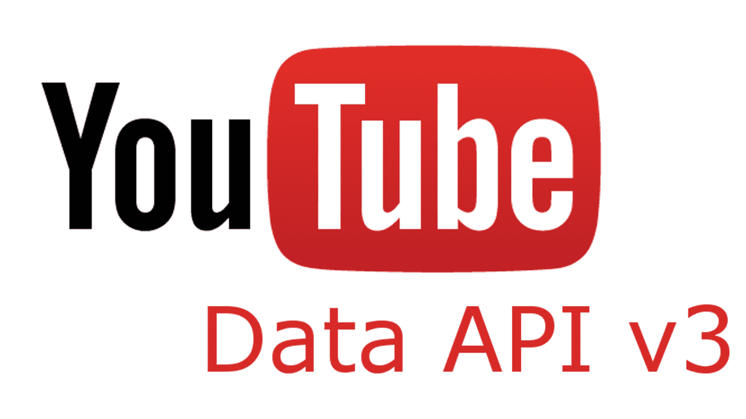

9. Technology Stack
MERN Stack:
MongoDB
ExpressJS
ReactJS
NodeJS
APIs Used:
Cloudinary [For Images]
Google Cloud Developer Tools [For authentication and sending mails]
YouTube [For Entertainment]
WeatherAPI

Slide 19
10. Suggestions In Review 1
Report paper to be published after App Development
Include Scalability for future prospects

Slide 20
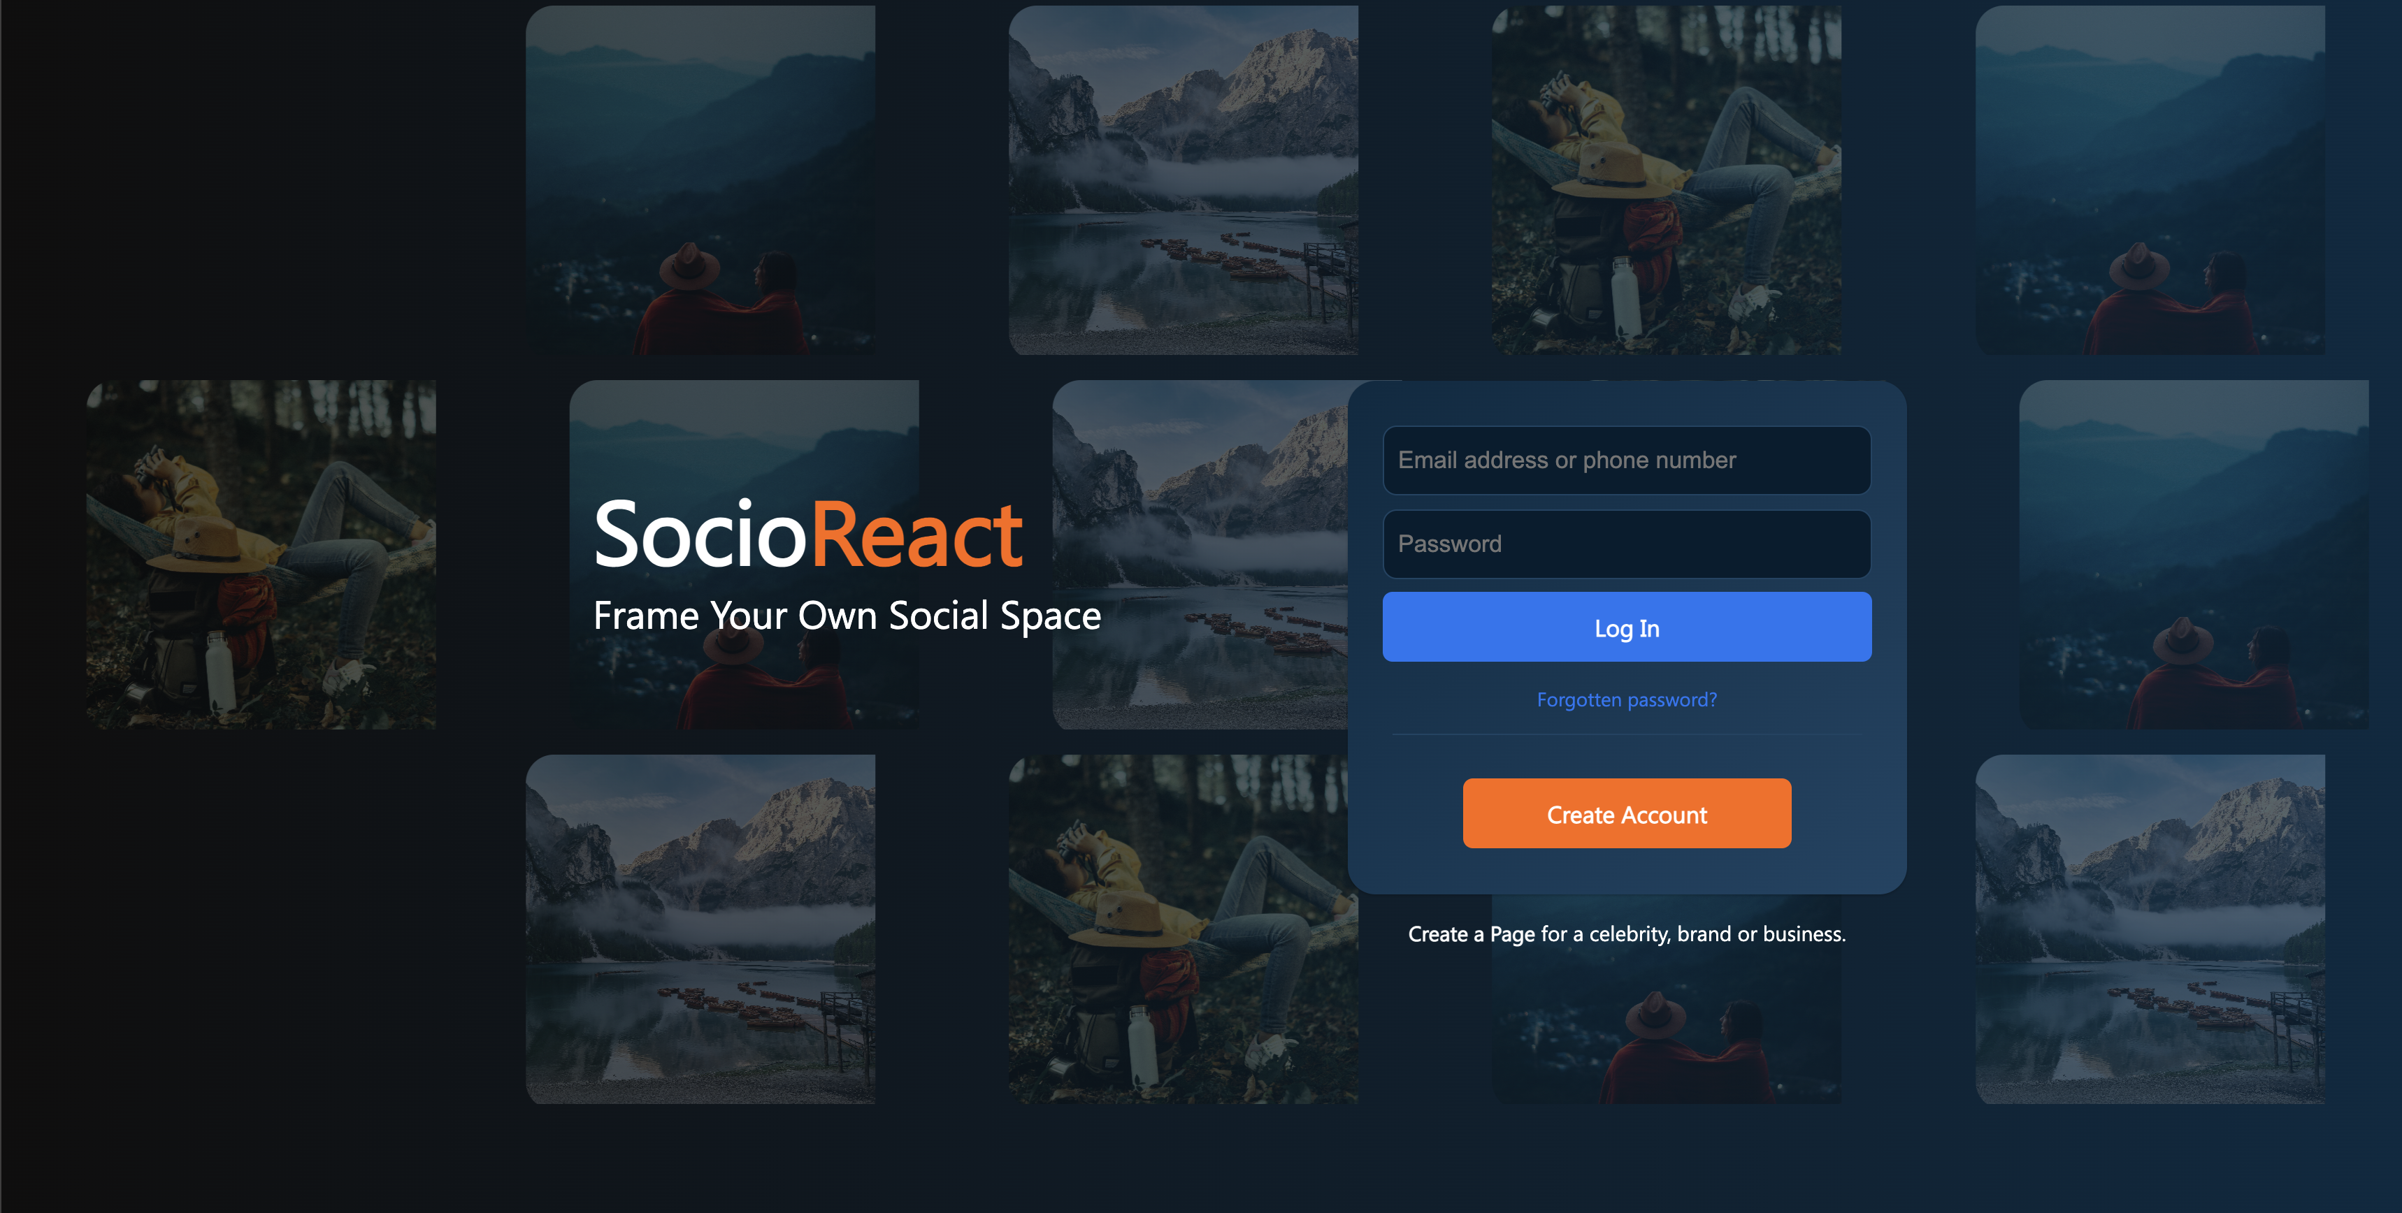
11. Results and Discussions
Log In Page

Slide 21
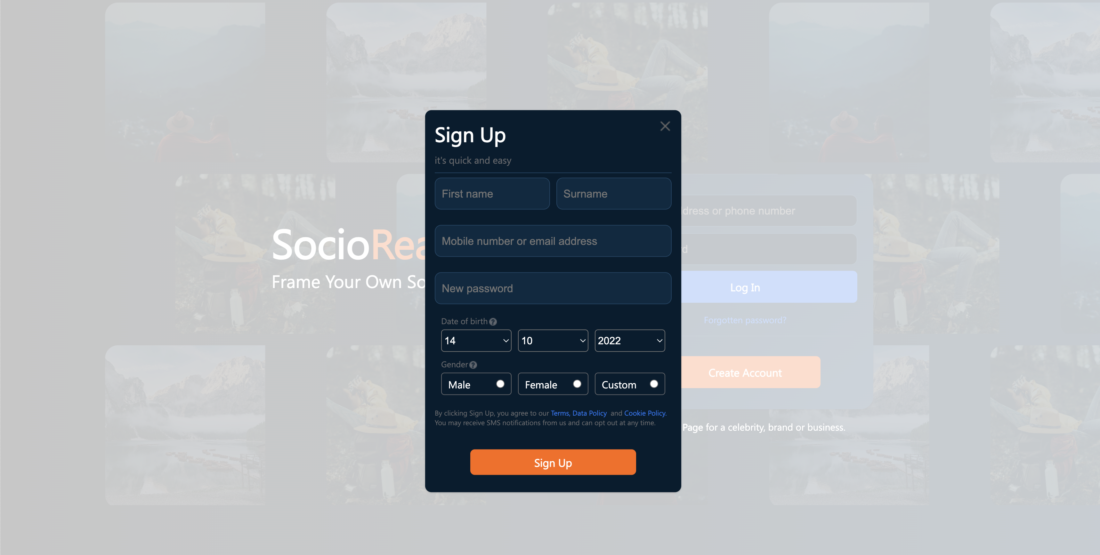
11. Results and Discussions
Sign Up Page

Slide 22
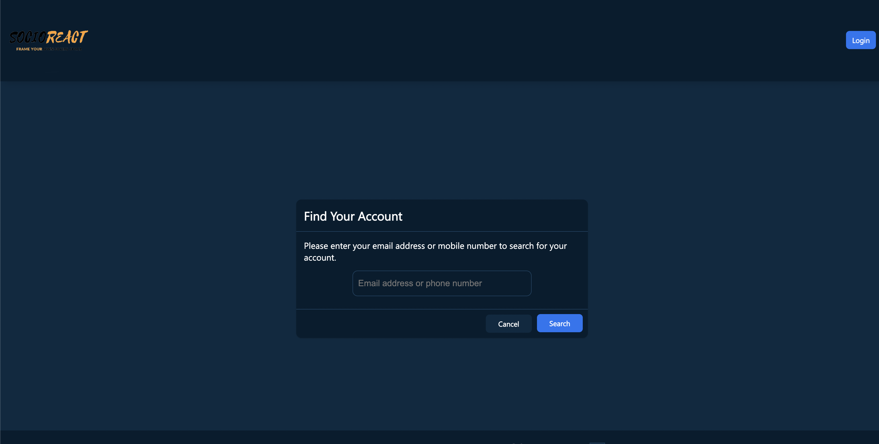
11. Results and Discussions
Forgot Password Page

Slide 23
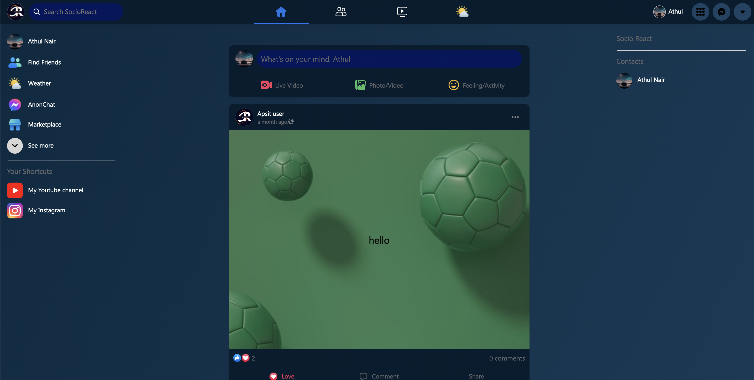
11. Results and Discussions
Home Page

Slide 24
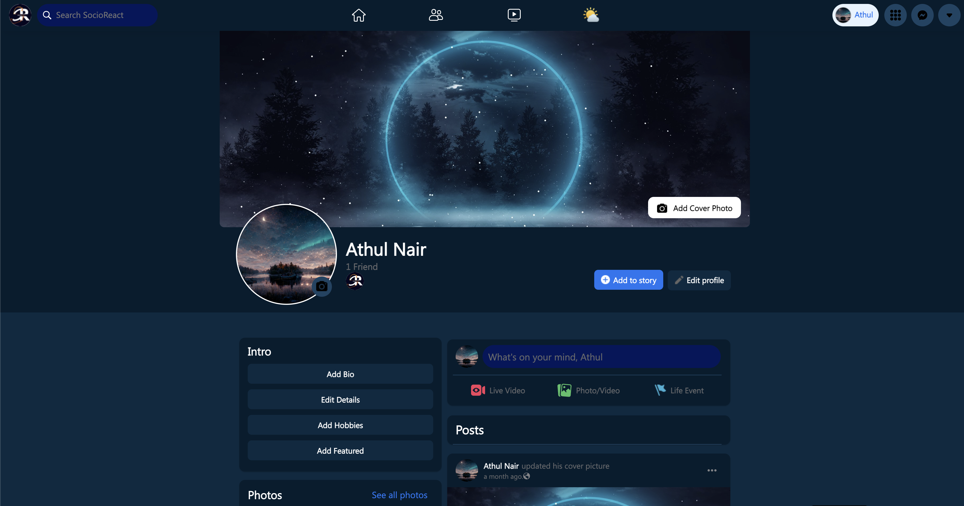
11. Results and Discussions
Profile Page

Slide 25
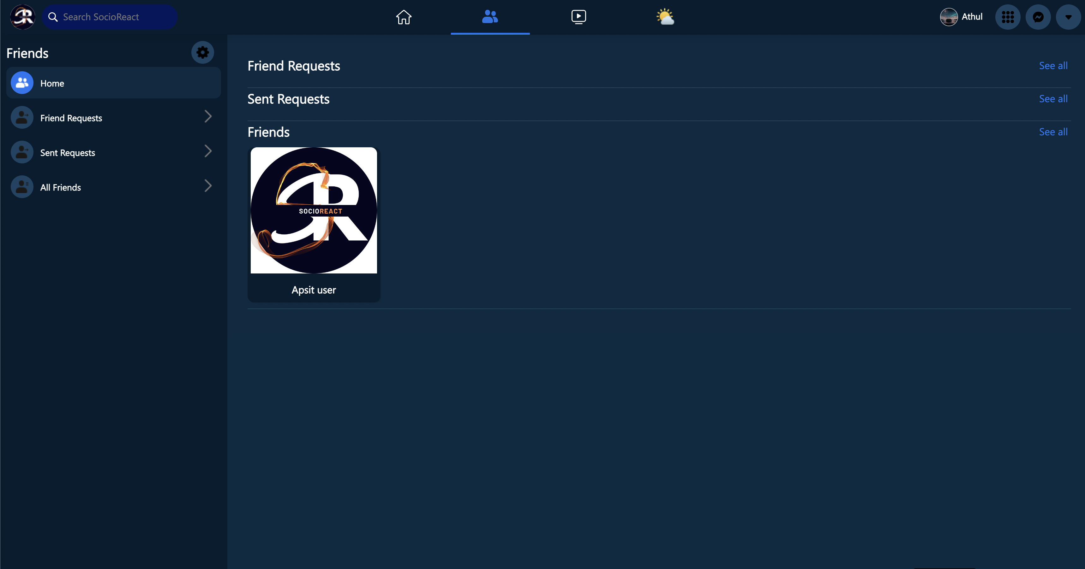
11. Results and Discussions
Friends Page

Slide 26
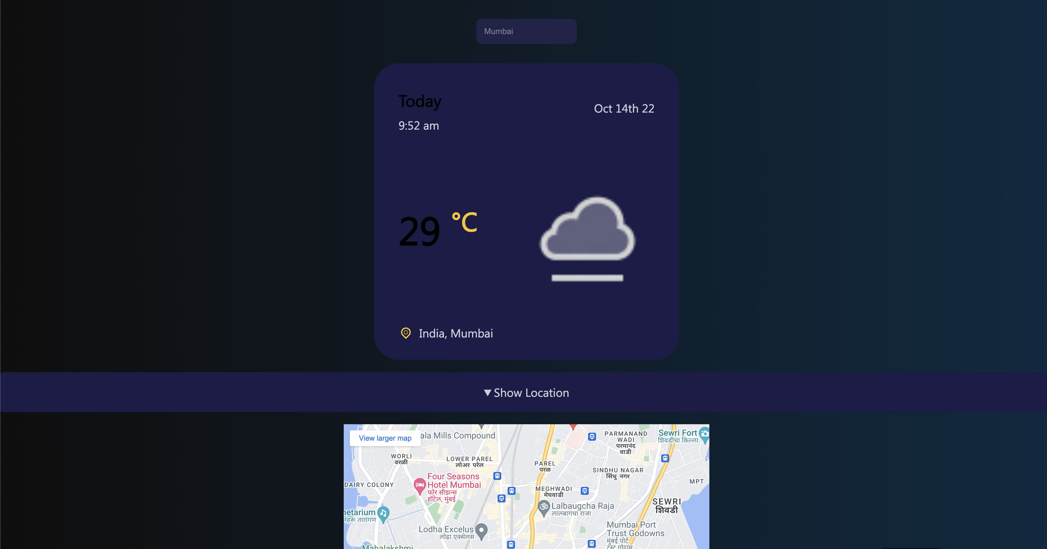
11. Results and Discussions
Weather Info Page

Slide 27
12. Conclusion and Future Scope
The Project Entitled “SocioReact” is developed using ReactJs, Express JS, Node JS and MongoDB as database. This Project covers all the basic requirements of users.
Social media refers to the means of interactions among people in which they create, share, and/or exchange information and ideas in virtual communities and networks and also it has become the most effective platform for the entertainment and business purpose.
SocioReact would also be helpful for students in various fields such as gaining knowledge, getting various ideas about ongoing activities all over the world, reaching out towards large audiences, etc.

Slide 28
Reference
A Review of Facebook Research in the Social Sciences [https://pubmed.ncbi.nlm.nih.gov/26168459/] By Robert E Wilson 1, Samuel D Gosling , Lindsay T Graham.
The Academic Usage of Social Networking Sites [https://www.researchgate.net/publication/335374266] By R.Subramani (Phd)
Udemy - UDEMY - Build Facebook clone with REACT JS AND THE MERN STACK 2022 [https://www.udemy.com/course/build-facebook-clone-and-master-react-js-mern-stack-2022/]
How to Use MERN Stack: A Complete Guide [https://www.mongodb.com/languages/mern-stack-tutorial]

Slide 29
Thank You...!!

